Slide 1
[EXAMPLE] <product or solution> for the
<customer>
Project Kickoff
Red Hat Consulting
<Date>

Slide 2
Purpose & Agenda
Purpose
To ensure all details are finalized and the engagement is set up for success.
Agenda
Introductions & Contact Info
Scope & Schedule
Logistics
Customer Survey
Questions

Slide 3
INTRODUCTIONS

Slide 4
Red Hat Project Team
Introductions
Name | Title | Phone | Email
 | Senior Territory Services Manager
 | Service Delivery Manager
 | Senior Consultant
The project is led by a Services Delivery Manager (SDM) who coordinates the efforts of the Red Hat Consulting delivery team. The Red Hat SDM is the Red Hat point of contact for the the project engagement. The SDM will drive the Red Hat project timeline, issue resolutions, manage the Red Hat resources, and continually communicate the project status.

Slide 5
[Customer] Project Team
Introductions
Name | Title | Phone | Email
John Doe | Computer Services Lead (A) | (601) 634-2494 (o) (601) 832-6249 (m) | johndoe@johndoe.com

Slide 6
SCOPE & SCHEDULE

Slide 7
Scope
Goals & Objectives
[Example] -Enter your scope here
Complete install of Satellite 6 in ERDC virtual environment
Configure initial clients
Establish process for registering clients
Advanced Satellite 6 configurations
Driven by ERDC staff
Mentoring & enablement

Slide 8
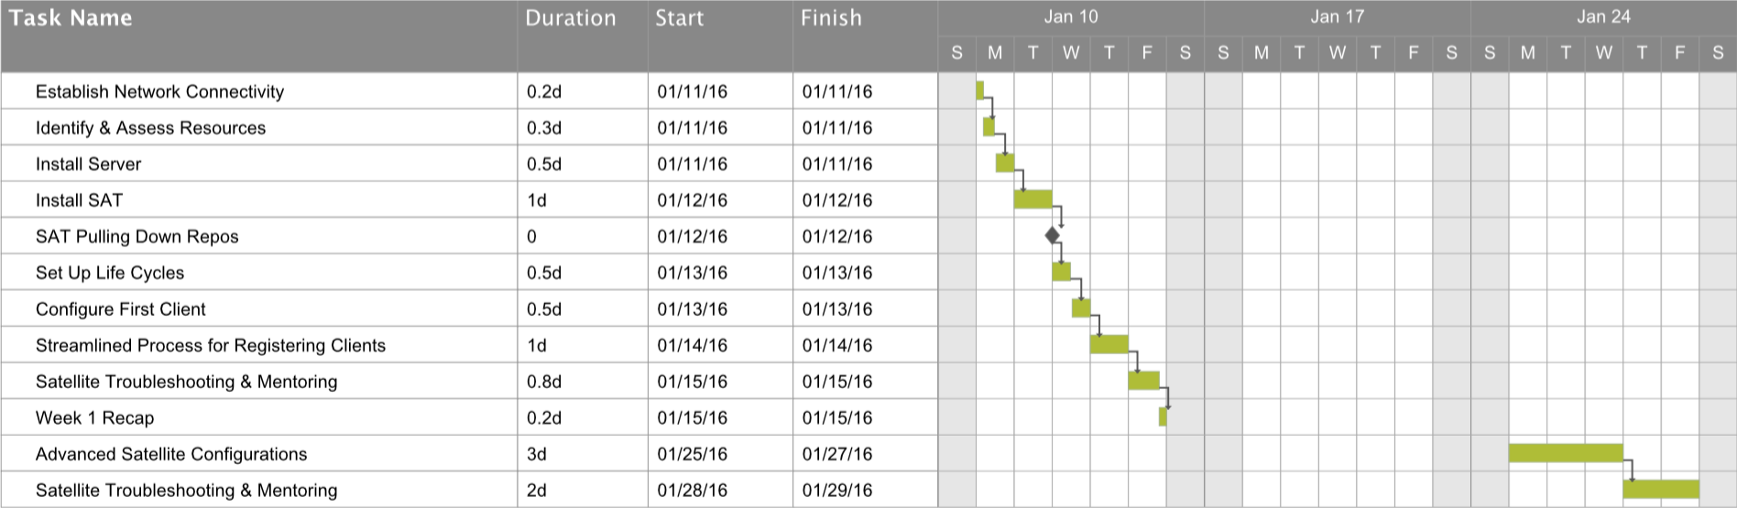
Schedule
[Example] Weeks of 11 Jan and 25 Jan
Week 2 schedule will be refined as part of Week 1 Recap to meet the needs of [Customer] staff.

Slide 9
LOGISTICS

Slide 10
Logistics
[Example] Places of Performance
Primary
Information Technology Laboratory (ITL) 1165 Porters Chapel Road Vicksburg, MS 39180
Check-In (0830 Monday)
ERDC HQ PAO 3909 Halls Ferry Road Vicksburg, MS 39180

Slide 11
Logistics
[Example] POC & Access
On-Site Customer Contact
Allyson Windham allyson.l.windham@usace.army.mil (601) 634-2494 (o) (601) 832-6249 (m)
Physical Access Requirements
U.S. Citizenship: U.S. Government-issued photo ID (e.g., driver’s license, passport) required at main gate for entrance into ERDC
Public Affairs Office (PAO) will issue visitor badge
Park in Visitor Parking in front of ITL

Slide 12
Logistics
[Example] Getting Started
Aaron and Kris will meet Allyson at PAO at 0830 Monday
After getting badged, Allyson will escort Aaron and Kris to ITL
Team introduction upon arrival at ITL
Hike!

Slide 13
Customer Survey
Red Hat is committed to a quality customer experience and continuous improvement in our services. Your feedback is the most important factor in determining if we’ve met your expectations and what we can do to improve. You will be receiving a customer satisfaction survey at the conclusion of our engagement. Please take just a few minutes to provide us with an honest snapshot of your experience. In the meantime, if there are any areas of concern, issues or problems on the project, please don’t hesitate to reach out to <PM or Lead Consultant Name>

Slide 14
QUESTIONS

Slide 15
Questions
Discussion Points

Slide 16
THANK YOU

